Slide 1
CROP RELATED PATTERN AND CROP DISEASE DETECTION USING DATA MINING AND DENSENET-121
GUIDE DETAILS:
DR. R. GEETHA RAMANI
STUDENT DETAILS:
SAMUNDAR SINGH
2019272033
MCA(SS) 2019-22

Slide 2
MOTIVATION & OBJECTIVE
Objective:
To Help the farmer by giving crop production estimation.
Help them to take correct step for increasing the crop Production.
Provide an analysis of weather and forecasting.
Detect the correct measure of fertilizer so that it help farmer as well as reduce the soil pollution.
Help farmer to detect the disease of crop in more accurate way and also provide remedy.
Motivation:
The increase in population leads to scarcity of food, due to which prices increases day-by-day. We have enough resources and knowledge but it is meaningless unless it is used in proper way so that with correct parameters all the capable land are in used to produce correct outputs.
A second opinion is always needed to every person for better decision. The farming process are needed to be done in systematic way.

Slide 3
INTRODUCTION
Predicting the crop yield in advance of its harvest would help the policy makers and farmers for taking appropriate measures for marketing and storage.
This project will help the farmers to know the yield of their crop before cultivating onto the agricultural field and thus help them to make the appropriate decisions.
The crop disease detection system have too much noise due to the background image so the background image is filtered which increase the accuracy of the model. Also the remedy for the disease is also provided

Slide 4
LITERATURE REVIEW
S.No. | Author name & Paper title | Concept in the paper (Algorithm, Advantages, Limitations, Future enhancement) | Paper details
1. | Crop Yield Estimation in India Using Machine Learning(Lasso Regression) (Ms Kavita ,Information Technology Manipal University Jaipur) | The model shrinks some coefficients and sets others to 0, and hence tries to retain the useful features it increase the productivity of code. | https://ieeexplore.ieee.org/stamp/stamp.jsp?arnumber=9250915 Date : Oct 30-31, 2020
2. | Crop Yield Prediction Using Random Forest Algorithm for Major Cities in Maharashtra State (Kiran Moraye , Aruna Pavate, Suyog Nikam and Smit Thakkar, , Atharva College of Engineering, Mumbai) | Random forest algorithm creates decision trees on different data samples and then predict the data from each subset and then by voting gives better the solution for the system. Random Forest used the bagging method to trained the data. Basically, the bagging method is a mixture of studying different models and increase the final result of the system. | https://www.ijircst.org/DOC/7-crop-yield-prediction-using-random-forest-algorithm-for-major-cities-in-maharashtra-state.pdf Date: 2, March 2021
3. | MULTIPLE PLANT LEAF DISEASE CLASSIFICATION USING DENSENET-121 ARCHITECTURE (Aswin Vellaichamy S, Akshay Swaminathan , C Varun and Dr. Kalaivani S, Vellore Institute of Technology, Vellore, Tamilnadu, India) | Images in the dataset have background information which is unnecessary for disease detection in leaves of crops. This is overcome by RGB color form image to HSV form, segmenting required portion of image by histogram based thresholding and hole-filling ending into a binary mask image and then masked by dot multiplication on the binary mask, finally resizing it for neural network training | https://iaeme.com/MasterAdmin/Journal_uploads/IJEET/VOLUME_12_ISSUE_5/IJEET_12_05_005.pdf Date: 5, May 2021

Slide 5
DATASET DETAILS
1. Crops area and production dataset (Category 2) link : http://data.icrisat.org/dld/src/crops.html
This dataset contain total 20 state 314 district and 29 crops data over time period of 52 years (1966-2017)
Size : 16146 rows and 79 columns
2. Crop wise Irrigated data (Category 2) link : http://data.icrisat.org/dld/src/crops.html
This dataset contain total 20 state 314 district and 21 crops irrigation data over time period of 52 years (1966-2017)
Size : 14504 rows and 24 columns
3. Crop wise fertilizer Consumption data (Category 4) link : http://data.icrisat.org/dld/src/crops.html
This dataset contain total 20 state 314 district and Nitrogen potash and phosphate data over time period of 52 years
Size : 16047 rows and 20 columns
4. Monthly Rainfall data and temperature (Category 7) link : http://data.icrisat.org/dld/src/crops.html
This dataset contain total 20 state 314 district with Monthly rainfall and temperature of 52 years (1966-2017)
Size : 14527 rows and 17 columns
5. Plant Disease Dataset link : www.kaggle.com/new-plant-diseases-dataset
This dataset total 38 folder with different plant disease data with 12 type of different plants leaves.
Size : 54400+ imagesn having total size (3GB)

Slide 6
IMPLEMENTATION PLATFORM / FRAMEWORK
For Frontend : Angular
For Backend : Django and NodeJS
Libraries : pandas, numpy, sklearn, plotly, tensorflow, tensorflow,opencv

Slide 7
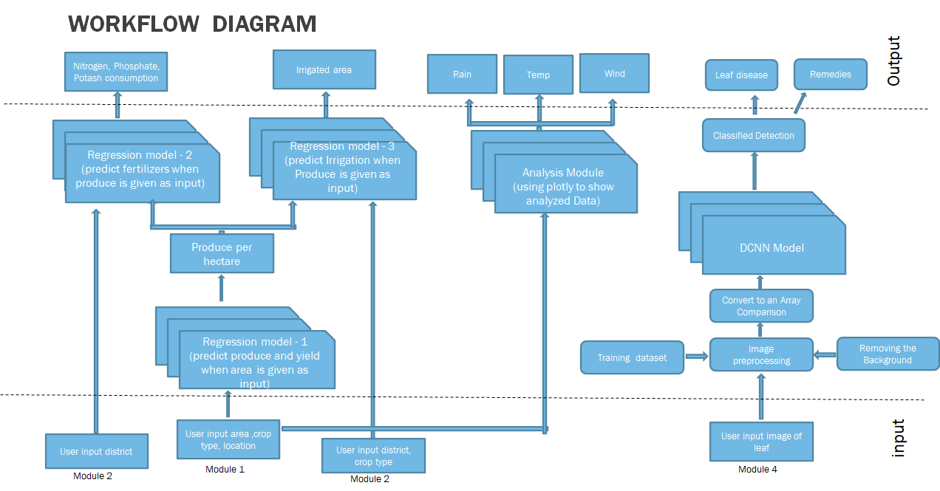
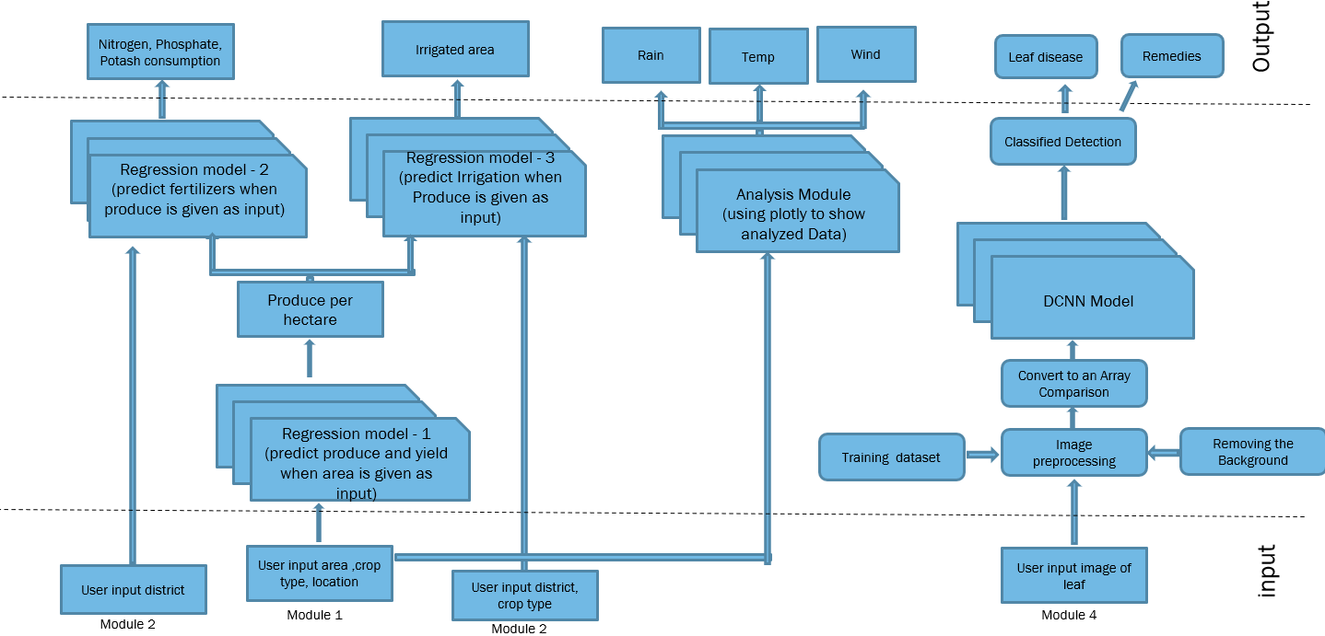
OVERALL ARCHITECTURE

Slide 8
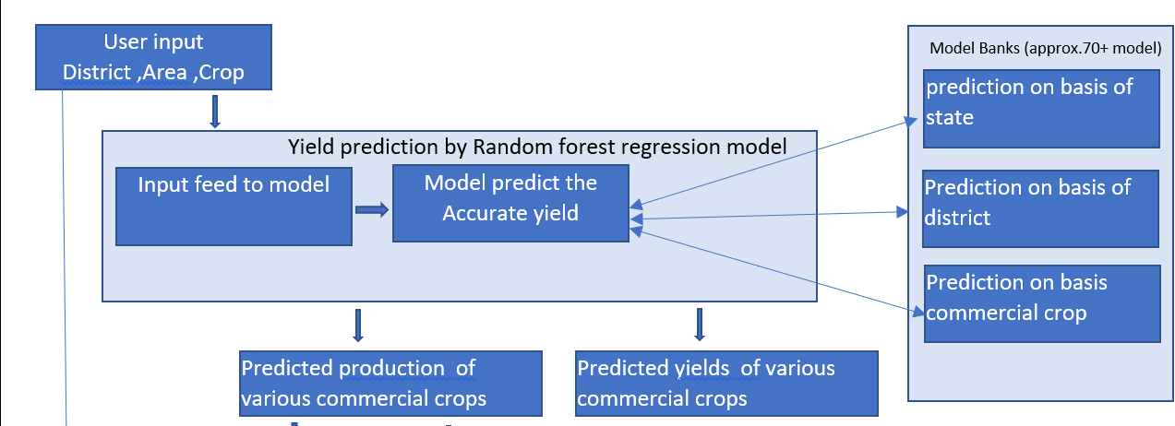
MODULE 1 (a)
Description :Predict the production of crop.
This module will take area as input from user and type of crop, The user have to fill district and crop type. This model will predict the produce as well as the yield.
There is separate models for each scenario is created which is stored in model bank. Which produce output as per requirements

Slide 9
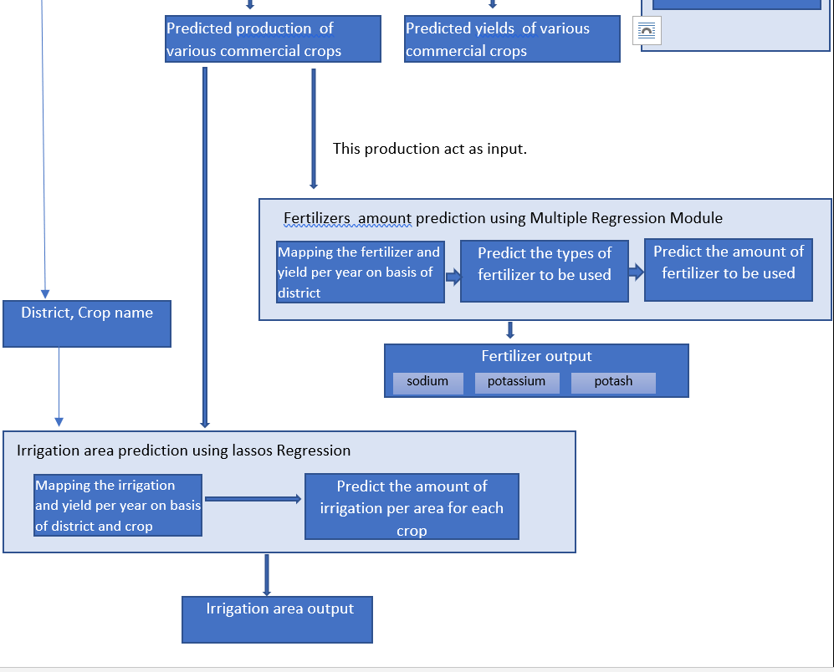

MODULE 1 (b)
Description :Predict the fertilizer and irrigation amount of crop.
This module will take District, crop name, produce as input and on basis of that by using lassos regression predict the irrigation. Lassos regression is used to reduce the loss.
It also take the produce and district name as input and provide amount of fertilizer like (sodium, potassium and potash) used to get that produce. There are some constraint set that avoid the farmer to use the fertilizer in huge amount.

Slide 10
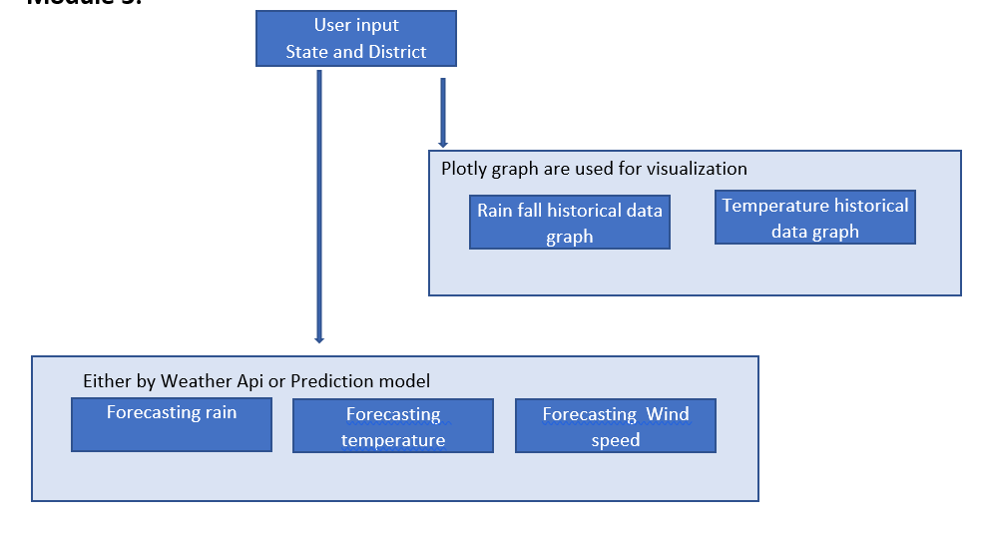
MODULE 2
Description :Rainfall ,temperature and Wind Analysis and forecasting
The historic data is used and all statistics regarding the rainfall, temperature and other factor are shown in term of visualization. Plotly graph are used to achieve visualization and make it more interactive.
There is a table of weather which shows the forecast of next 5 days. That help the farmer to take proper decision.

Slide 11
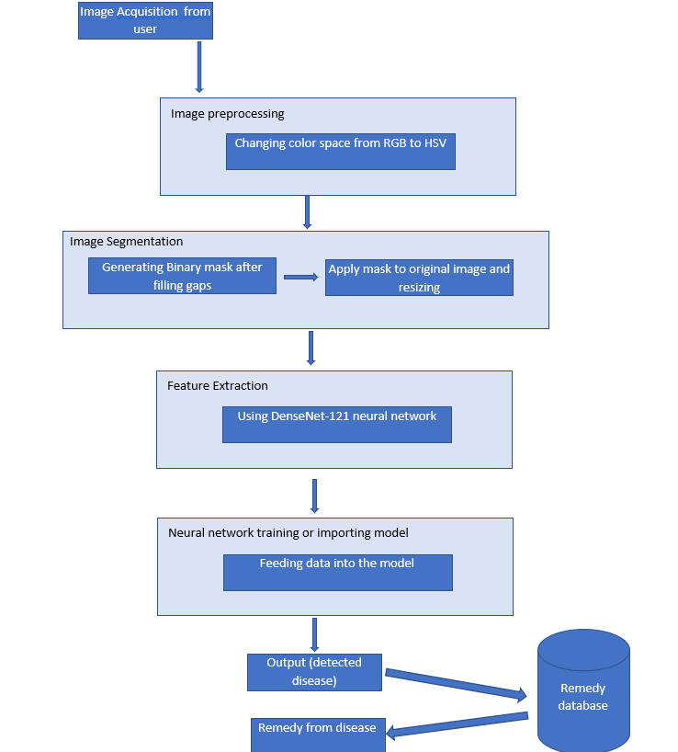
MODULE 3
Description :plant disease detection and providing remedy.
In this module the background noise of image is removed by changing the colour from RGB to HSV
Then the image is superposed in a black background so that only the leaf image is used for training the same binary masking technique is used to take input from user.
The dense net 121 neural network is used to train the data. To gain maximum accuracy.

Slide 12
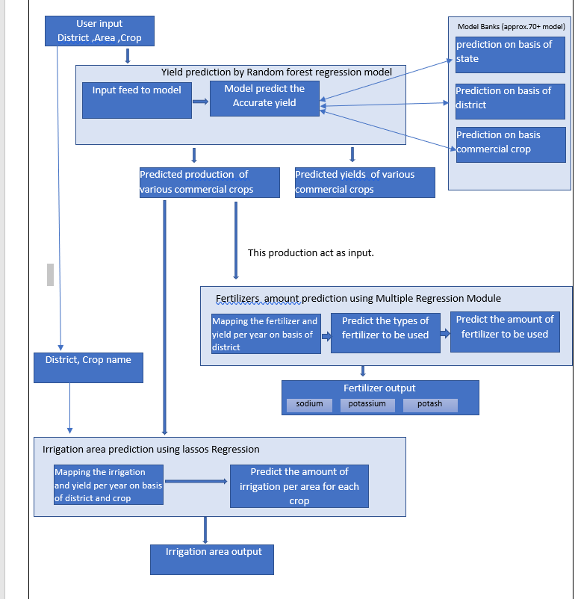
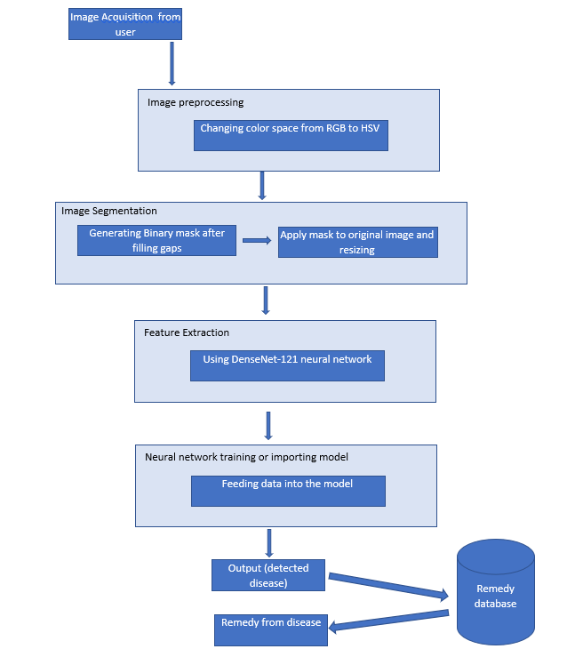
Overall Diagram of Modules
Module 1
Module 4

Slide 13
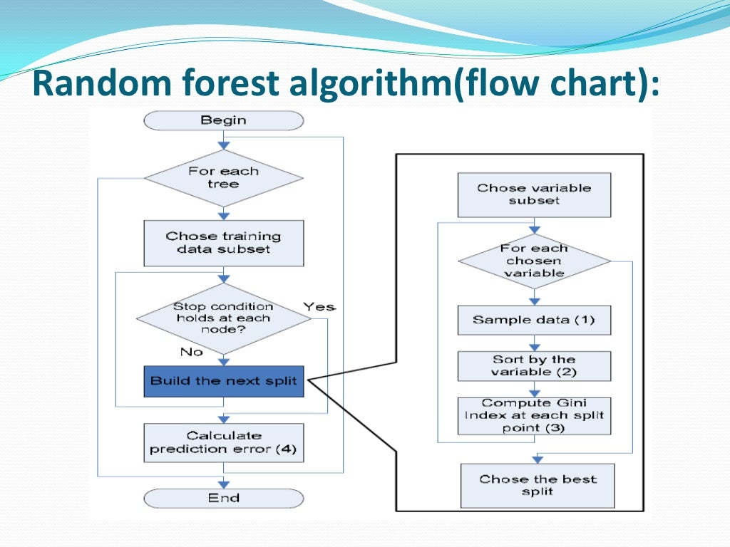
Crop Produce Prediction Algorithm
Step 1: Start.
Step 2: Take input dataset.
Step 3: clean the dataset.
Step 4: create data frame for individual crop.
Step 5: Split the data frame in training and testing set.
Step 6: Choose training data subset.
Step 7: Choose Variable Subset using Random forest tree.
Step 8: Sort by the variable.
Step 9: Compute Gini index at each split.
Step 10: Choose the best Split.
Step 11: Dump the model
Step 12: Stop

Slide 14
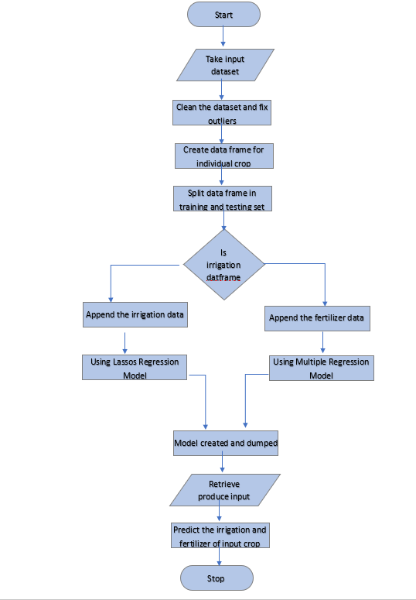
Fertilizers and Irrigation prediction algorithm
Step 1: Start.
Step 2: Take input dataset.
Step 3: Clean the dataset.
Step 4: Create data frame for individual crop.
Step 5: Split the data frame in training and testing set.
Step 6: Choose training data subset.
Step 7: Choose regression model (Lassos and multiple).
Step 8: Create the model
Step 9: Dump the model
Step 10: Retrieve Produce input from module 1
Step 11: Show the output.
Step 12: Stop

Slide 15
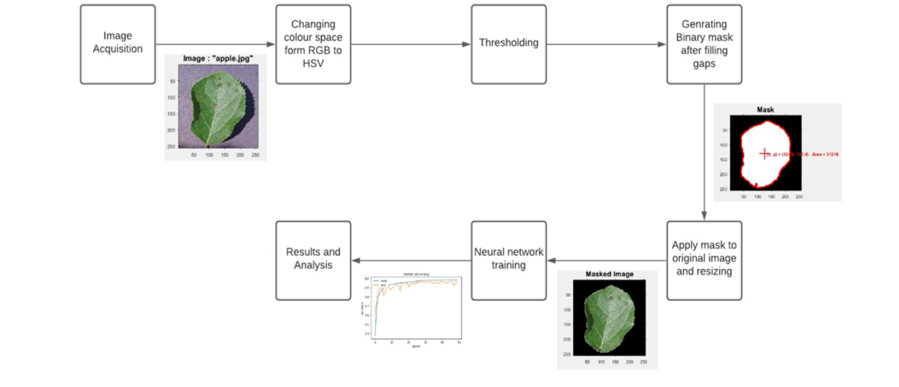
Crop disease detection Algorithm
Step 1: Start.
Step 2: Take input dataset of images.
Step 3: Convert the RGB to HSV format.
Step 4: Generate Binary Mask after filling gaps.
Step 5: Apply mask to the original image and Resizing it.
Step 6: Choose Dense net- 121 Neural network model .
Step 7: Feed the Processed training image to the model .
Step 8: Train the model.
Step 9: Dump the model.
Step 10: Load model feed the input data into it.
Step 11: Fetch the detected disease.
Step 12: Fetch the Remedy of the Disease.

Slide 16
REFERENCES
https://ieeexplore.ieee.org/stamp/stamp.jsp?arnumber=9250915
https://www.ijircst.org/DOC/7-crop-yield-prediction-using-random-forest-algorithm-for-major-cities-in-maharashtra-state.pdf
https://iaeme.com/MasterAdmin/Journal_uploads/IJEET/VOLUME_12_ISSUE_5/IJEET_12_05_005.pdf

Slide 17
THANK YOU

